Slide 1

Nutrition and non-communicable disease risk factors
A talk by Simon Müller
for the lecture Introduction to Data Science

Slide 2
Introduction
Data & Methods
Data Sources
Principal Component Analysis
Clustering
Results
Scatter plots
K-Means clustering
Correlations
Conclusion

Slide 3
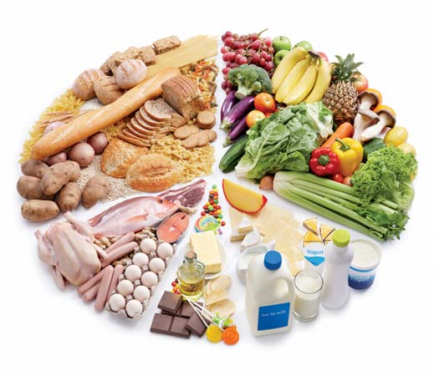
Introduction and Goals
Combination of world nutrition, health indicator and GNI per capita datasets
Apply Principal Component Analysis and clustering to find interesting patterns in the data
Quantify the correlation between different food groups, health indicators and income

Slide 4

Data Sources
Nutrition database:
FAO.org
Food Balance Sheets (1961 – 2013)
Item of interest: Food supply (kcal/capita/day)
The data is aggregated by food groups.
Notes:
Food and Agriculture Organisation of the United Nations
Food Balance sheets: Describes the pattern of a country’s food supply during a reference period
Food group examples: Animal- and vegetable products, total calories, pulses, fruit, meat and so on

Slide 5

Data Sources
Health indicator database:
WHO.int
Global Health Observatory data
Non-communicable diseases
Common risk factors include unhealthy diet, overweight, raised blood pressure, blood sugar and cholesterol
Notes:
Non-communicable diseases: Heart disease, stroke, cancer, chronic respiratory diseases and diabetes
Invisible epidemic presenting an under-appreciated cause of poverty and hinders the economic development of many countries
Common but modifiable risk factors underlie the major NCDs
In this talk: Unhealthy diet, obesity, raised blood pressure, blood sugar and cholesterol

Slide 6
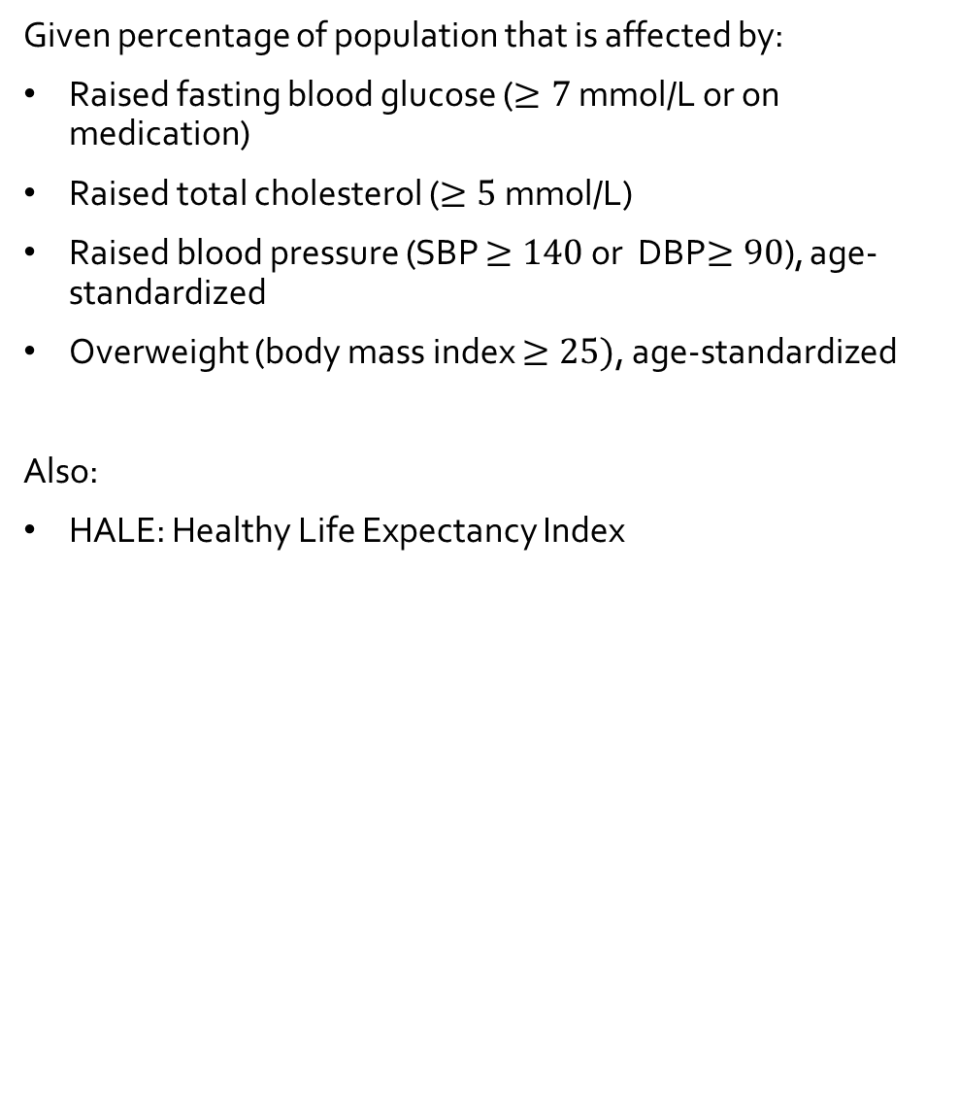
Data Sources
Given percentage of population that is affected by:
Raised fasting blood glucose ($≥7$ mmol/L or on medication)
Raised total cholesterol ($≥5$ mmol/L)
Raised blood pressure (SBP $≥140$ or DBP$≥90$), age-standardized
Overweight (body mass index $≥25)$, age-standardized
Also:
HALE: Healthy Life Expectancy Index
Notes:
Some important definitions before we move on.

Slide 7

Data Sources
GNI per capita to estimate income:
data.worldbank.org
Latest (2015) values in USD
This dataset is only used for the correlation part of this talk

Slide 8
Principal Component Analysis
Reminders:
PCA emphasizes variation and can be used to reduce the dimensionality of a dataset
It involves finding linear combinations of a set of variables that has maximum variance and removing its effect
In my case:
Up to 20 dimensional dataset
PCA allows to visualise the data in two or three dimensions
Notes:
Principal component analysis is a technique used to emphasise variation and to bring out strong patterns in a data set
The dataset I used is up to 20-dimensional when using the detailed food group aggregation combined with the risk factors for NCDs

Slide 9
Clustering
Flat clustering with the K-Means algorithm
Metric used: Distance between points
Parameter: Number of clusters (n = 6)
Six regions: Africa, Americas, Europe, Eastern Mediterranean, South-East Asia, Western Pacific
Notes:
- I used the K-Means algorithm with the number of clusters set to 6 due to the fact that the FAO splitting the countries in six regions:

Slide 10
Introduction
Data & Methods
Data Sources
Principal Component Analysis
Clustering
Results
Scatter plots
K-Means clustering
Correlations
Conclusion

Slide 11
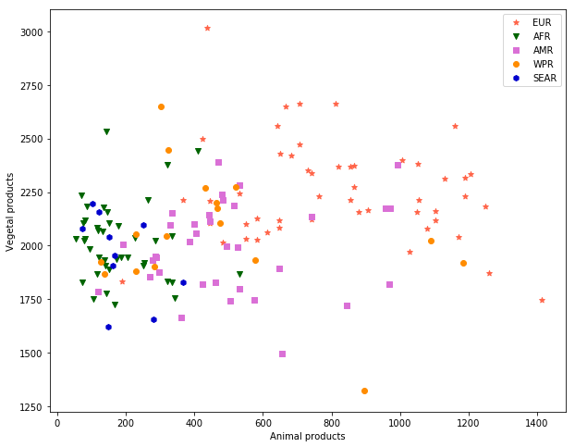
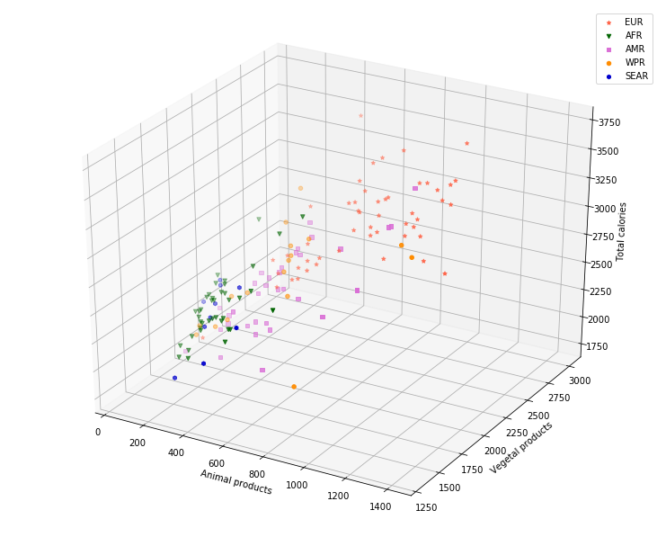
Scatter plots
Let’s start with something we can plot without manipulation
Notes:
These plots use the only the nutrition data where the food has been aggregated into ‘Animal products’, ‘Vegetal products’ and the total calories available.

Slide 12
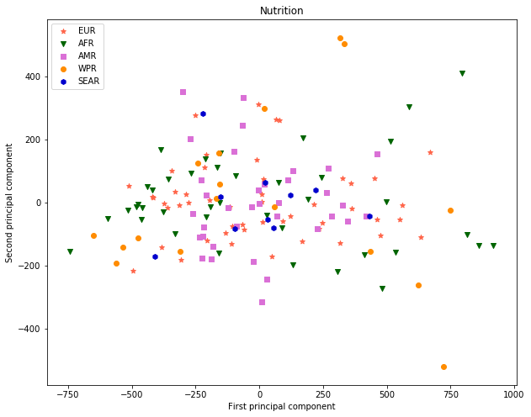
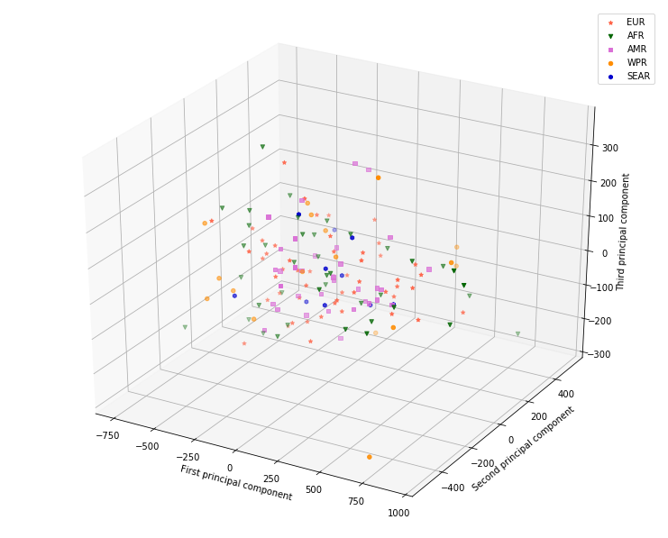
Scatter plots
PCA on the full nutrition data set

Slide 13
Scatter plots
Comparison
Notes:
Let’s compare the two dimensional scatter plots

Slide 14
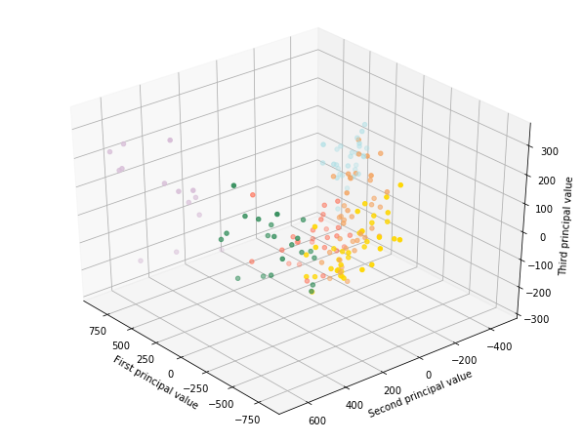
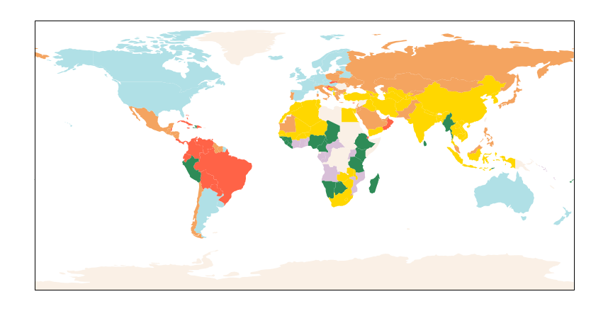
K-Means clustering
Initiate K-Means clustering with n = 6 clusters (number of world regions)
Use PCA on the full data to reduce it to three dimensions

Slide 15
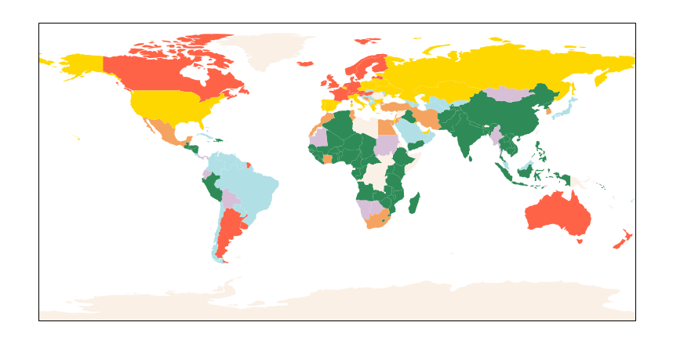
K-Means clustering
Clustering on the coarsely aggregated nutrition data
Notes:
This means the data is just two dimensional: Vegetal and animal products
Some differences compared to the previous map: For example, Canadians appear to be more European than before! Also African countries now most belong to the same cluster

Slide 16
K-Means clustering
We can use clustering on n-dimensional data and then use the world map to visualise the result
Next slide: Clustering based on only the nutrition data versus the health indicator data

Slide 17
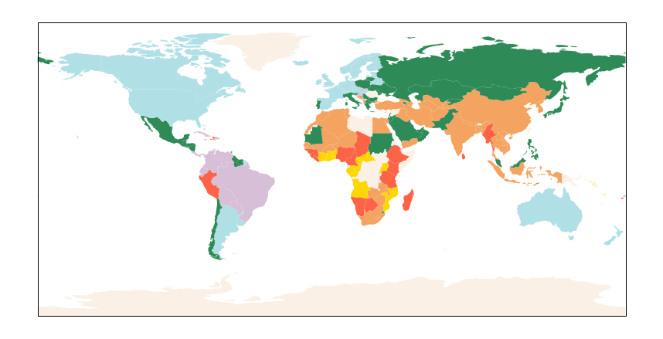
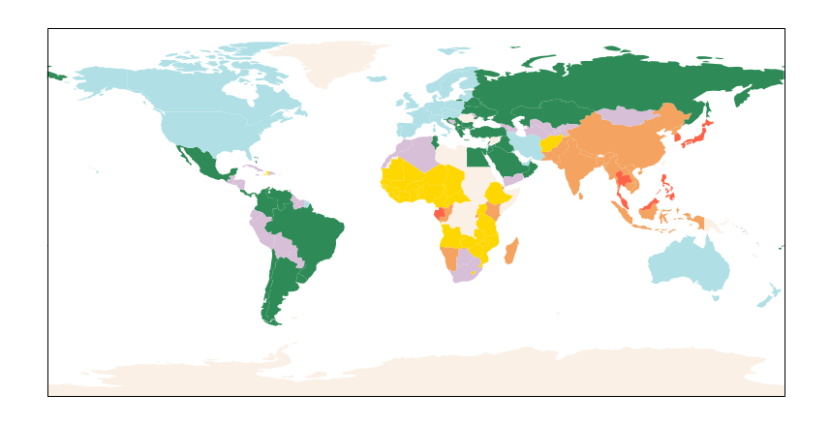
Notes:
Top: Countries coloured by their clustering based on the full detailed nutrition data
Bottom: Countries coloured by their cluster based on the health indicator data

Slide 18
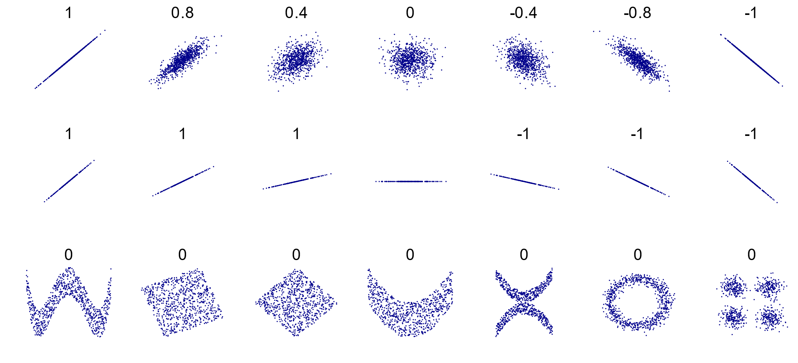
Correlations
We can use the Pearson Correlation Coefficient (PCC) to try and quantify correlations.
Generally used interpretation:
0.1 < r <0.3: Small
0.3 < r < 0.5 : Moderate
r > 0.5: Strong
Caution: Only valid when considering linear relations
Credits: Wikipedia
Notes:
Where I called r the absolute value of the correlation coefficient
We can now look at the correlation coefficients and see which pairs of variables are worth investigating
To this end, I normalised the nutrition data by total calories consumed such that the ratio of a certain food group to total calories is considered. The caloric needs may vary across the board and this puts more emphasis on the type of food that is consumed.

Slide 19
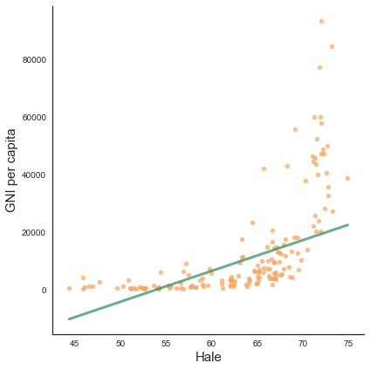
Notes:
Perhaps linear correlation at the beginning, but a lot of outliners in the very rich countries – at some point, more money is not the limiting factor to life expectancy anymore
In general: Richer nations have more money available for healthcare

Slide 20
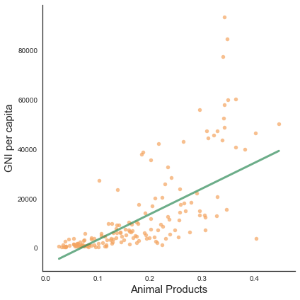
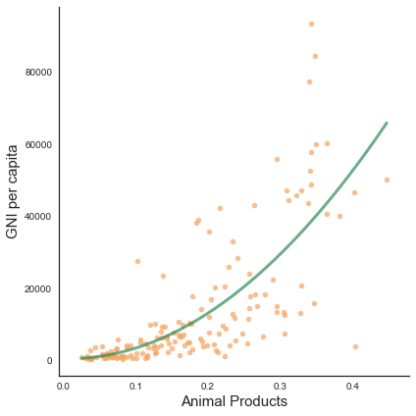
Notes:
- Linear relation at the start, but it trails off at large income values: At some point, one may simply not consume a larger amount of food

Slide 21
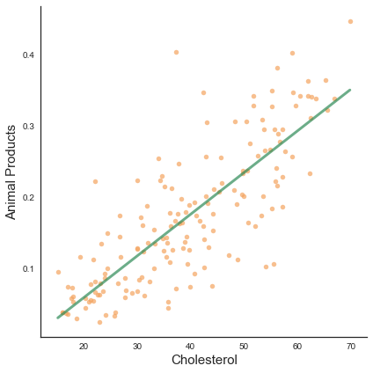
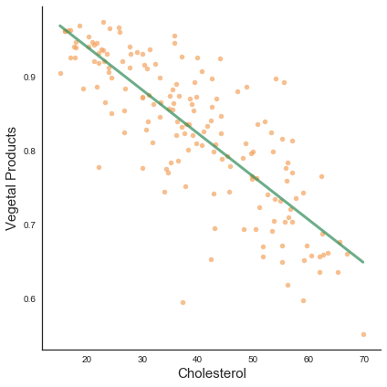
Notes:
Note the sort of funny correlation between the healthy life expectancy index and the vegetal products consumption
Obviously this cannot be the whole story: But as we saw, richer nations generally tend to eat more animal products while poorer eat more vegetal products
Richer nations also usually have better health care systems
This should be seen as a cautionary tale of over-interpreting correlations:

Slide 22
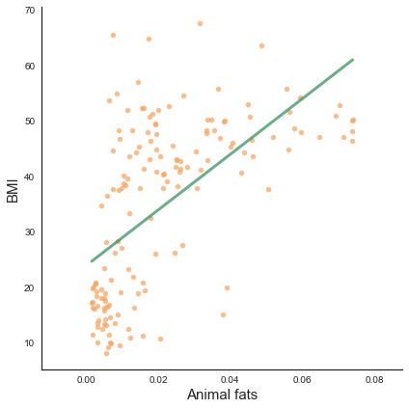
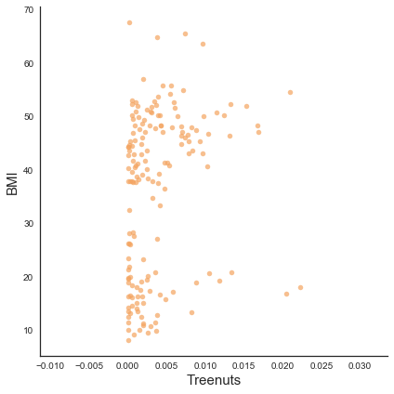
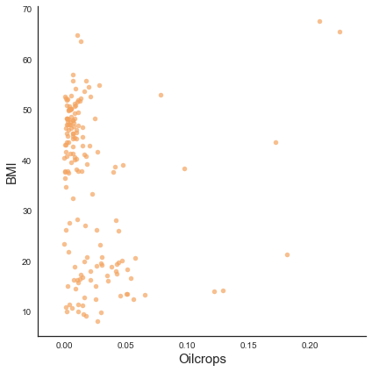
Notes:
Now with the full data, let’s focus on a few interesting findings:
Comparison of the different high caloric fatty foods
Cereals and Pulses
Next slide: Comparison of Fruits and Sugar & Sweeteners (both high in sugar, but different correlations)

Slide 23
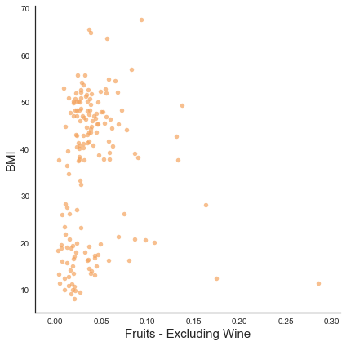
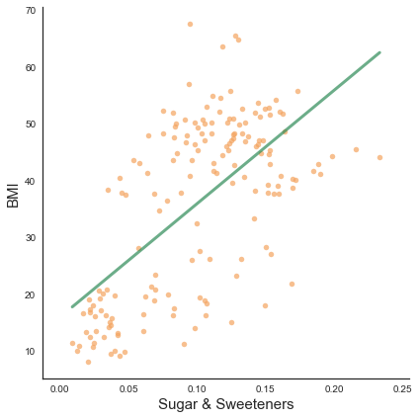
Notes:
To me it was surpising that I did not find stronger effects of the food consumption on blood pressure and blood glucose ; if you had asked me before the project where one may find correlations, I would have surely assumed to find some there.
Also of note is the fairly modest correlation between cereals/pulses on overweight and raised cholesterol

Slide 24

Conclusion
PCA reduced data managed to preserve clustering of original data.
Clustering when looking at nutrition and health indicator separately is consistent.
Be aware of deadly vegetables: Apply caution when using correlation coefficients.
Nonetheless: Interesting trends may be found
Let the data tell its story – don’t get too caught up in your own narrative.

Slide 25
Thank you for listening!
Sources:
Food balance sheets:
fao.org/faostat
Global Health Observatory: who.int/gho/database
GNI per capita:
data.worldbank.org
Python libraries used:
numpy, pylab, pandas, cartopy, seaborn, scipy, sklearn
Interesting visualisation to toy around with:
http://www.nationalgeographic.com/what-the-world-eats/

Slide 26
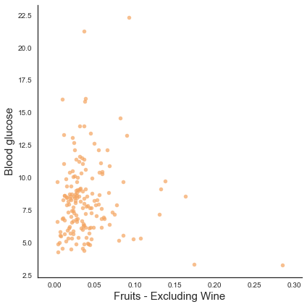
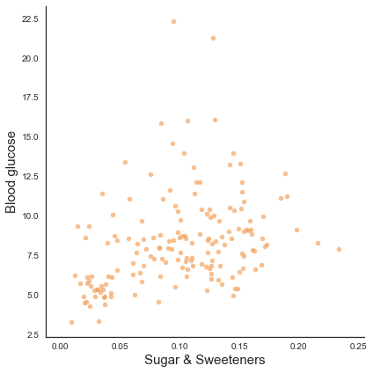
Backup

Slide 27
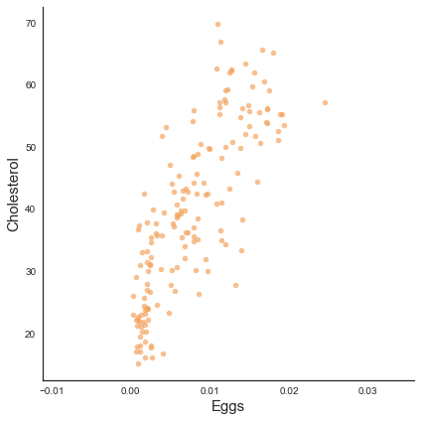
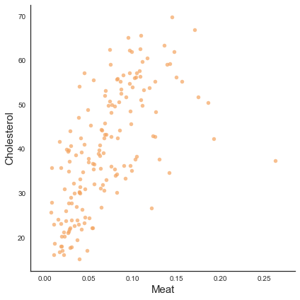
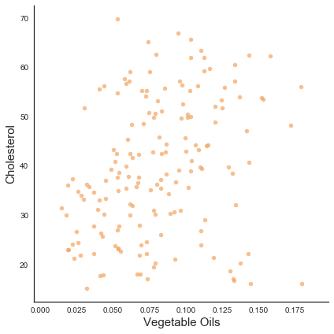
Backup

Slide 28
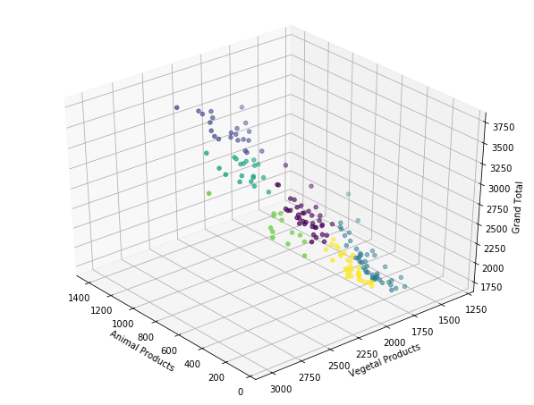
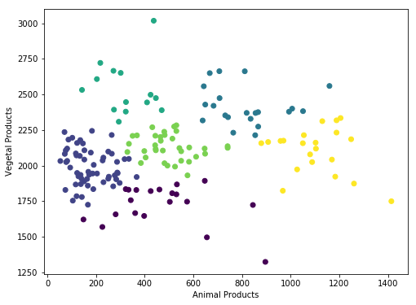
Backup
Notes:
- Clustering in the coarsely aggregated nutrition data

Slide 29
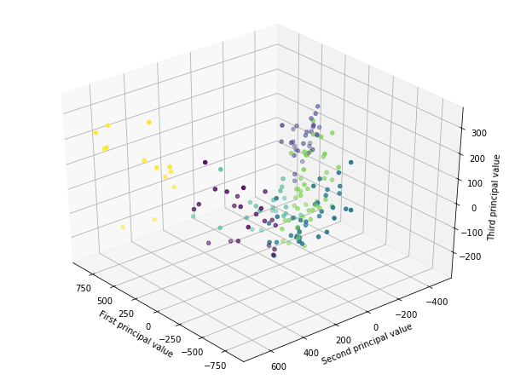
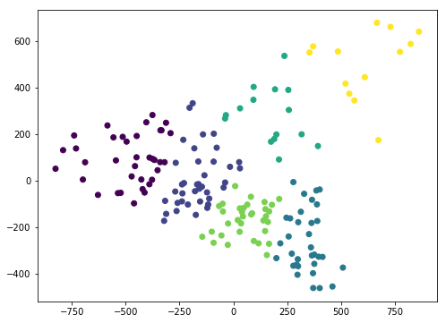
Backup
Notes:
- Clustering in the full nutrition data

